Slide 1
Data Mining: Introduction
Lecture Notes for Chapter 1
Introduction to Data Mining, 2nd Edition
by
Tan, Steinbach, Karpatne, Kumar

Slide 2


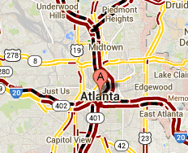
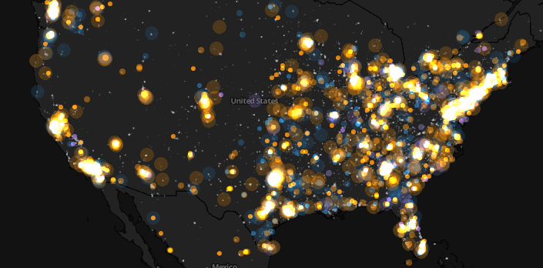
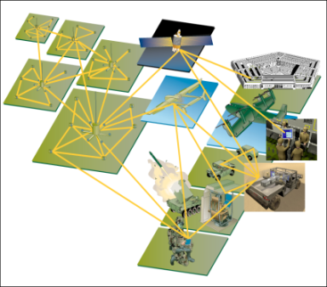
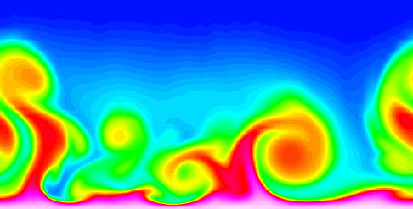
Large-scale Data is Everywhere!
There has been enormous data growth in both commercial and scientific databases due to advances in data generation and collection technologies
New mantra
Gather whatever data you can whenever and wherever possible.
Expectations
Gathered data will have value either for the purpose collected or for a purpose not envisioned.
E-Commerce
Cyber Security
Traffic Patterns
Social Networking: Twitter
Sensor Networks
Computational Simulations
Notes:
2

Slide 3




Why Data Mining? Commercial Viewpoint نضره تجاريه
Lots of data is being collected and warehoused
Web data
Google has Peta Bytes of web data
Facebook has billions of active users
purchases at department/ grocery stores, e-commerce
Amazon handles millions of visits/day
Bank/Credit Card transactions
Computers have become cheaper and more powerful
Competitive Pressure is Strong اكثر تنافس
Provide better, customized services for an edge (e.g. in Customer Relationship Management)
Notes:
3

Slide 4
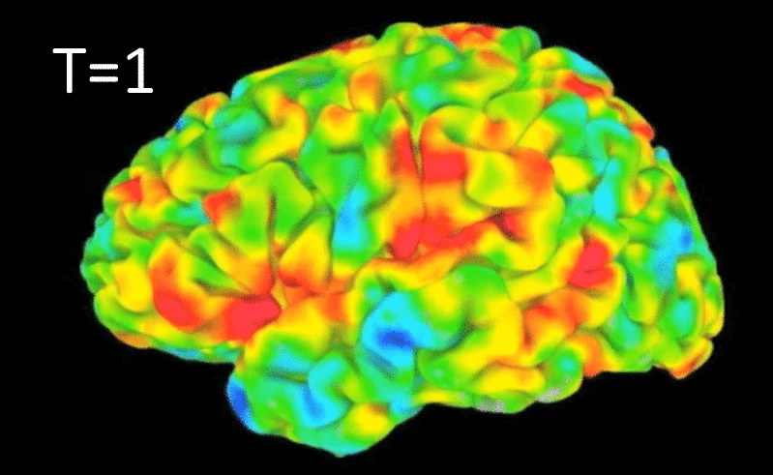
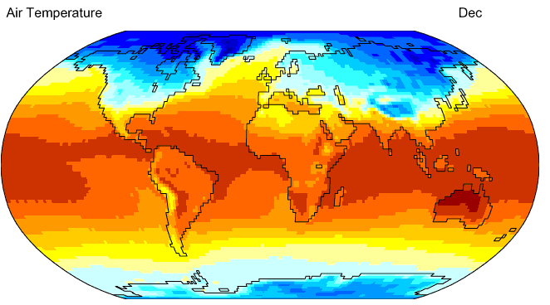
Why Data Mining? Scientific Viewpoint
Data collected and stored at enormous speedsبسرعات هاءله
remote sensors on a satellite
NASA EOSDIS archives over petabytes of earth science data / year
telescopes scanning the skies
Sky survey data
High-throughput biological data عالية الانتاج
scientific simulations المحاكاة العلمبه
terabytes of data generated in a few hours
Data mining helps scientists
in automated analysis of massive datasetsالتحليل الالي لمجموعات البيانات الضخمه
تكوين القرضيات
In hypothesis formation
fMRI Data from Brain
Sky Survey Data
Gene Expression Data
Surface Temperature of Earth
Notes:
4

Slide 5
What is Data Mining?
Many Definitions
Non-trivial extraction of implicit, previously unknown and potentially useful information from data استحراج غير تافه للمعلومات الضمنبه وغير معروفة سابقا
Exploration & analysis, by automatic or semi-automatic means, of large quantities of data in order to discover meaningful patterns

Slide 6
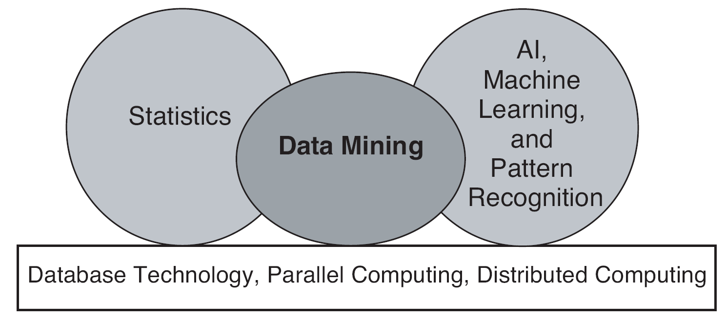
Origins of Data Mining اصول
Draws ideas from machine learning/AI, pattern recognition, statistics, and database systems
Traditional techniques may be unsuitable غير مناسبهdue to data that is
Large-scale
High dimensional
Heterogeneousغير متجانسه
Complex
Distributed
A key component of the emerging field of data science and data-driven discovery

Slide 7
Data Mining Tasks
Prediction Methodsطرق التنبو
Use some variables to predict unknown or future values of other variables.
Description Methodsالوصف
Find human-interpretable patterns that describe the data.
From [Fayyad, et.al.] Advances in Knowledge Discovery and Data Mining, 1996

Slide 8
What is (not) Data Mining?
What is not Data Mining?
Look up phone number in phone directory
Query a Web search engine for information about “Amazon”
What is Data Mining?
Certain names are more prevalent in certain US locations (O’Brien, O’Rurke, O’Reilly… in Boston area)
بعض الاسماء الاكثر انتشارا في بعض المواقع الامريكيه
Group together similar documents returned by search engine according to their context (e.g. Amazon rainforest, Amazon.com,) قم بنجميع المستندات المتشابهه التي يعرضها محرك البحث

Slide 9


Data Mining Tasks …
Data
Clustering
Predictive Modeling
منضمه
Anomaly Detection
Association ضمه
Milk

Slide 10
Exercise-1 Discuss whether or not each of the following activities is a data mining task.
Dividing the customers of a company according to their gender.
Dividing the customers of a company according to their profitability.
Computing the total sales of a company.
Sorting a student database based on student identification numbers.
Predicting the outcomes of tossing a (fair) pair of dice.
Predicting the future stock price of a company using historical records.
Monitoring the heart rate of a patient for abnormalities.
Monitoring seismic waves for earthquake activities.
Extracting the frequencies of a sound wave.

Slide 11
Exercise-1 Answers
Dividing the customers of a company according to their gender. No. This is a simple database query.
Dividing the customers of a company according to their profitability. No. This is an accounting calculation, followed by the application of a threshold. However, predicting the profitability of a new customer would be data mining.
Computing the total sales of a company. No. Again, this is simple accounting.
Sorting a student database based on student identification numbers. No. Again, this is a simple database query.
Predicting the outcomes of tossing a (fair) pair of dice. No. Since the die is fair, this is a probability calculation. If the die were not fair, and we needed to estimate the probabilities of each outcome from the data, then this is more like the problems considered by data mining. However, in this specific case, solutions to this problem were developed by mathematicians a long time ago, and thus, we wouldn’t consider it to be data mining.

Slide 12
Exercise-1 Answers
Predicting the future stock price of a company using historical records. Yes. We would attempt to create a model that can predict the continuous value of the stock price. This is an example of the area of data mining known as predictive modelling. We could use regression for this modelling, although researchers in many fields have developed a wide variety of techniques for predicting time series.
Monitoring the heart rate of a patient for abnormalities. Yes. We would build a model of the normal behavior of heart rate and raise an alarm when an unusual heart behavior occurred. This would involve the area of data mining known as anomaly detection. This could also be considered as a classification problem if we had examples of both normal and abnormal heart behavior.
Monitoring seismic waves for earthquake activities. Yes. In this case, we would build a model of different types of seismic wave behavior associated with earthquake activities and raise an alarm when one of these different types of seismic activity was observed. This is an example of the area of data mining known as classification.
Extracting the frequencies of a sound wave. No. This is signal processing

Slide 13
Predictive Modeling: Classification
Find a model for class attribute as a function of the values of other attributes
Model for predicting credit worthiness
Class

Slide 14
Classification Example
categorical
categorical
quantitative
class
Test
Set
Learn
Classifier
Training
Set
Model

Slide 15
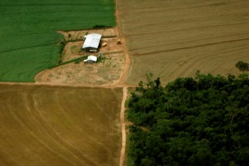
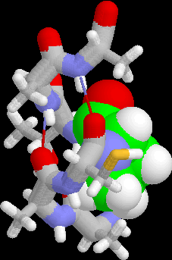
Examples of Classification Task
Classifying credit card transactions as legitimate or fraudulentمشروعه اة احتياليه
Classifying land covers (water bodies, urban areas, forests, etc.) using satellite data
Categorizing news stories as finance, الماليه,الترفيه weather, entertainment, sports, etc
Identifying intruders المتسلسلين in the cyberspace
Predicting tumor cells as benign or malignant السرطانيه
Classifying secondary structures of protein as alpha-helix, beta-sheet, or random coil

Slide 16
Classification: Application 1
Fraud Detection
Goal: Predict fraudulent cases in credit card transactions.
Approach:
Use credit card transactions and the information on its account-holder as attributes.
When does a customer buy, what does he buy, how often he pays on time, etc
Label past transactions as fraud or fair transactions. This forms the class attribute.
Learn a model for the class of the transactions.
Use this model to detect fraud by observing credit card transactions on an account.

Slide 17
Regression
Predict a value of a given continuous valued variable based on the values of other variables, assuming a linear or nonlinear model of dependency.
Extensively studied in statistics, neural network fields.
Examples:
Predicting sales amounts of new product based on advetising expenditure.
Predicting wind velocities as a function of temperature, humidity, air pressure, etc.
Time series prediction of stock market indices.

Slide 18
Clustering
Finding groups of objects such that the objects in a group will be similar (or related) to one another and different from (or unrelated to) the objects in other groups
Inter-cluster distances are maximized
Intra-cluster distances are minimized

Slide 19
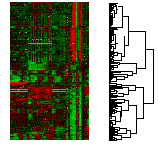
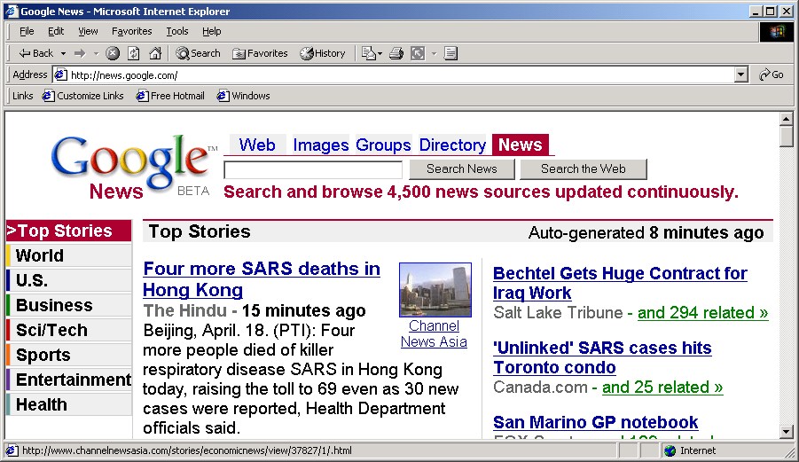
Applications of Cluster Analysis
Understanding
Custom profiling for targeted marketing
Group related documents for browsing
Group genes and proteins that have similar functionality
Group stocks with similar price fluctuations
Summarization
Reduce the size of large data sets
Courtesy: Michael Eisen
Use of K-means to partition Sea Surface Temperature (SST) and Net Primary Production (NPP) into clusters that reflect the Northern and Southern Hemispheres.

Slide 20
Association Rule Discovery: Definition
Given a set of records each of which contain some number of items from a given collection
Produce dependency rules which will predict occurrence of an item based on occurrences of other items.
Rules Discovered:
{Milk} --> {Coke}
{Diaper, Milk} --> {Beer}

Slide 21
Association Analysis: Applications
Market-basket analysis
Rules are used for sales promotion, shelf management, and inventory management
Telecommunication alarm diagnosis
Rules are used to find combination of alarms that occur together frequently in the same time period
Medical Informatics
Rules are used to find combination of patient symptoms and test results associated with certain diseases

Slide 22
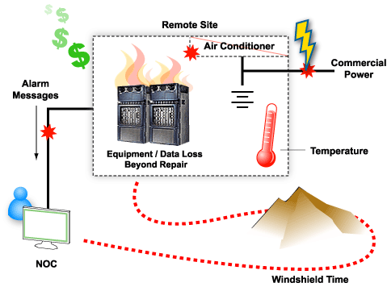

Slide 23
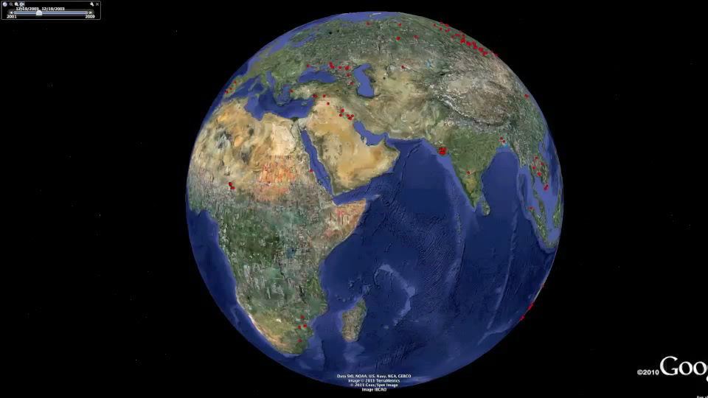
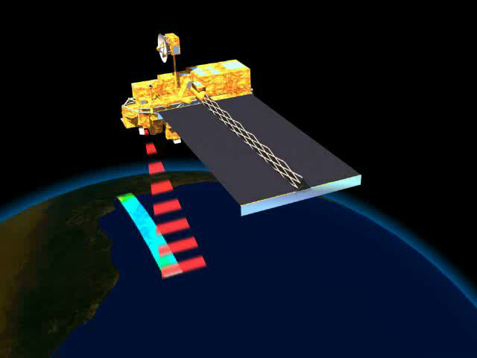
Deviation/Anomaly/Change Detection
Detect significant deviations from normal behavior
Applications:
Credit Card Fraud Detection
Network Intrusion Detection
Identify anomalous behavior from sensor networks for monitoring and surveillance.
Detecting changes in the global forest cover.

